Slide 1
Day 22
Extended Kalman Filter

Slide 2
Simple Mobile Robot
forward velocity
at time k
“state”
pose in world
coordinates
angular velocity
at time k
“control input”
velocities in world
coordinates

Slide 3
Plant Model
assuming time steps of size 1 and forward speed of V_{k}

Slide 4
Measurement Model
assume the robot can measure the distance to a beacon fixed in space at position [x_{b} y_{b}]^{T}

Slide 5
Matlab Simulation
% beacon locations in world
Nbeacon = 4;
beacon = [1 9 9 1;
1 1 9 9];
% TRUE STATE
% robot starts at [9 5] facing +y in world
% and travels in a circle of radius 4
Nstates = 360;
ang = [0:359] * pi/180;
xtrue = [4*cos(ang) + 5;
4*sin(ang) + 5;
ang + pi/2];
% TRUE MEASUREMENTS
delta = repmat(beacon(:), 1, length(ang)) - repmat(xtrue(1:2,:), 4, 1);
delta = delta .* delta;
ztrue = [sqrt(sum(delta(1:2,:)));
sqrt(sum(delta(3:4,:)));
sqrt(sum(delta(5:6,:)));
sqrt(sum(delta(7:8,:)))];

Slide 6
% NOISY MEASUREMENTS
z = ztrue + 0.2*randn(Nbeacon, Nstates);
% plant noise covariance
Cv = [0.1*0.1 0 0;
0 0.1*0.1 0;
0 0 0.01*0.01];
% measurement noise covariance
Cw = 0.2*0.2*eye(4);

Slide 7
% EKF ESTIMATION
x = zeros(3, Nstates);
P = zeros(3, 3, Nstates);
% linear velocity (radius * angular velocity)
V = 4 * (2*pi/360);
% initial state and covariance
x(:,1) = [0 0 pi/2]';
P(:,:,1) = eye(3);

Slide 8
for b = 2:Nstates
% the previous time index
a = b - 1;
% individual elements of state
xk = x(1,a);
yk = x(2,a);
thetak = x(3,a);
% predict state
xpred = x(:,a) + [V*cos(thetak);
V*sin(thetak);
pi/180];
% Jacobian of plant model
Jplant = [1 0 -V*sin(thetak);
0 1 V*cos(thetak);
0 0 1];
% predict state covariance
Ppred = Jplant * P(:,:,a) * Jplant' + Cv;

Slide 9
% Jacobian of measurement model
c1 = 1 / sqrt((xk - beacon(1,1))^2 + (yk - beacon(2,1))^2);
c2 = 1 / sqrt((xk - beacon(1,2))^2 + (yk - beacon(2,2))^2);
c3 = 1 / sqrt((xk - beacon(1,3))^2 + (yk - beacon(2,3))^2);
c4 = 1 / sqrt((xk - beacon(1,4))^2 + (yk - beacon(2,4))^2);
Jmeas = [c1*(xk - beacon(1,1)) c1*(yk - beacon(2,1)) 0;
c2*(xk - beacon(1,2)) c2*(yk - beacon(2,2)) 0;
c3*(xk - beacon(1,3)) c3*(yk - beacon(2,3)) 0;
c4*(xk - beacon(1,4)) c4*(yk - beacon(2,4)) 0];

Slide 10
% measurement prediction
zpred = [sqrt((xpred(1) - beacon(1,1))^2 + (xpred(2) - beacon(2,1))^2);
sqrt((xpred(1) - beacon(1,2))^2 + (xpred(2) - beacon(2,2))^2);
sqrt((xpred(1) - beacon(1,3))^2 + (xpred(2) - beacon(2,3))^2);
sqrt((xpred(1) - beacon(1,4))^2 + (xpred(2) - beacon(2,4))^2)];
% innovation
r = z(:,b) - zpred;
% innovation covariance
S = Jmeas * Ppred * Jmeas' + Cw;
% Kalman gain
K = Ppred * Jmeas' * inv(S);
% new state estimate
x(:,b) = xpred + K * r;
% new covariance estimate
P(:,:,b) = (eye(3) - K * Jmeas) * Ppred;
end

Slide 11
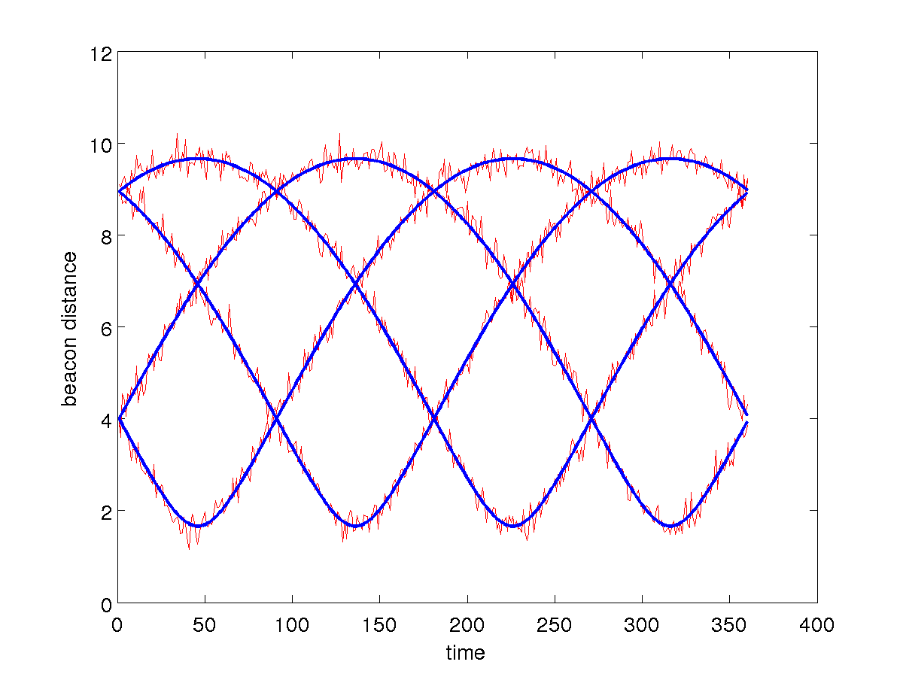
Real and Noisy Measurements

Slide 12
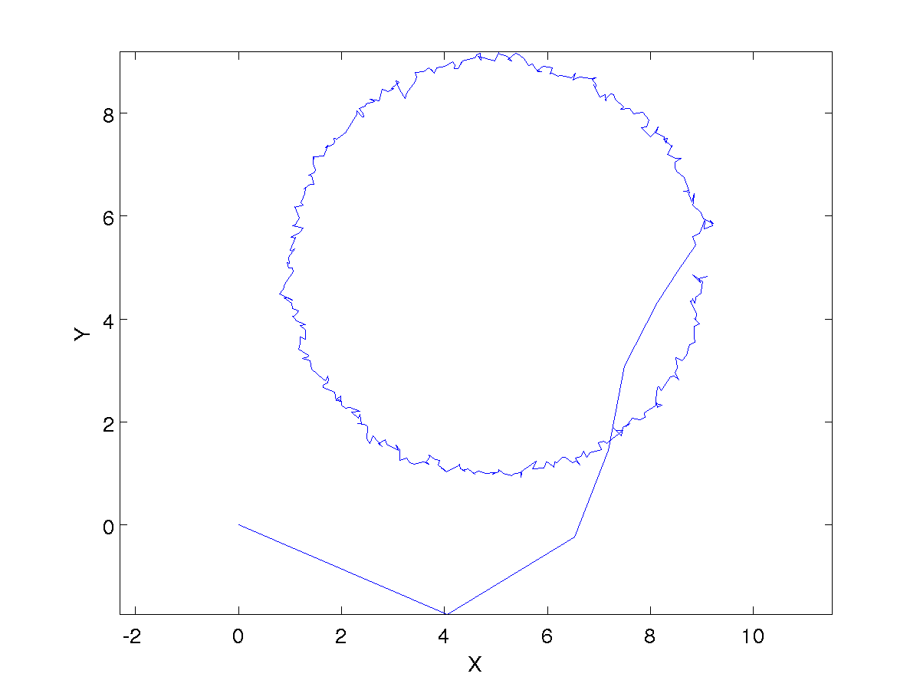
Estimated Position (poor initial state estimate)

Slide 13
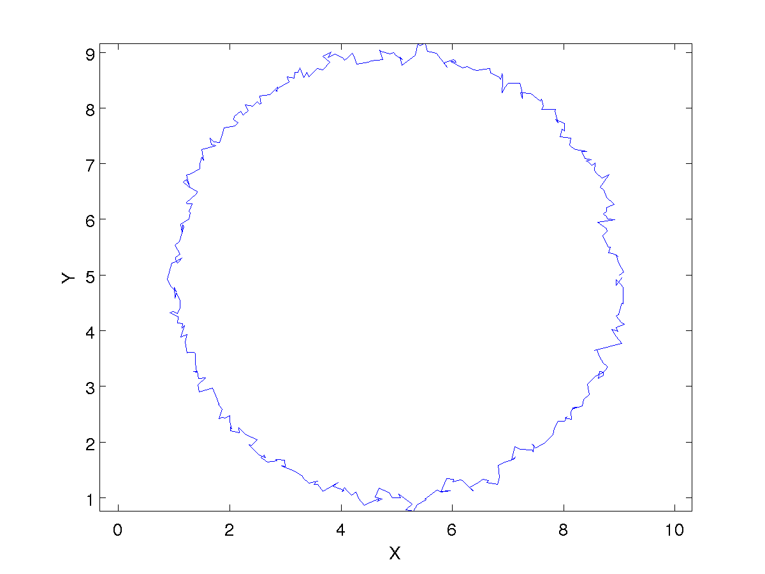
Estimated Position (good initial state estimate)

